Slide 1
Introduction to Python

Slide 2
Installation and Setup
https://www.python.org/

Slide 3
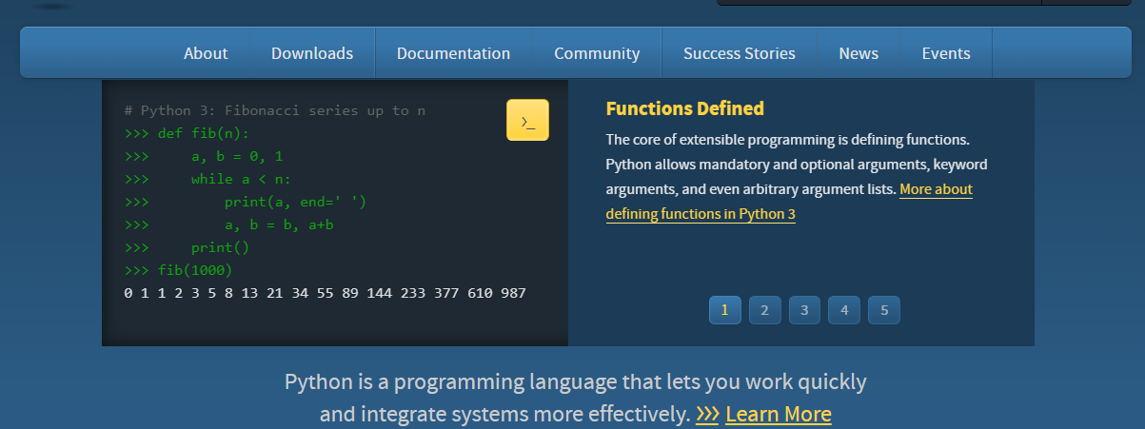
https://www.python.org/
Python homepage

Slide 4
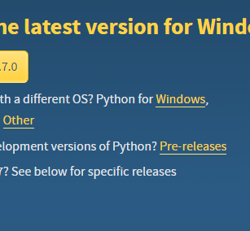
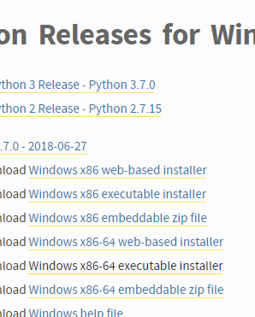
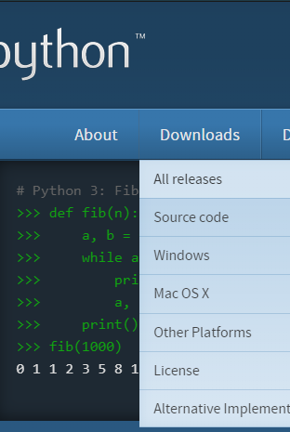
Download Python

Slide 5
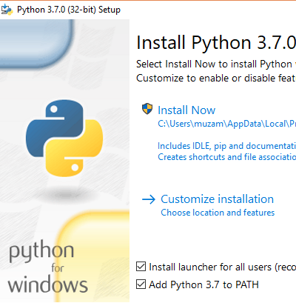
Python Installation

Slide 6
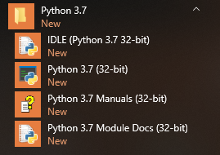
Python

Slide 7
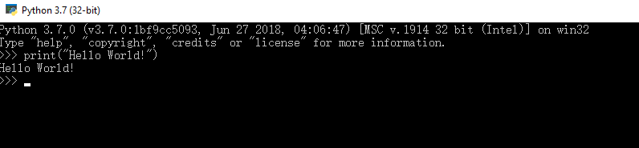
Hello World!

Slide 8
Numbers (1/3)
>>> 2 + 2
4
>>> 50 - 5*6
20
>>> (50 - 5*6) / 4
5.0
>>> 8 / 5 # division always returns a floating point number
1.6

Slide 9
Numbers (2/3)
>>> 5 ** 2 # 5 squared
25
>>> 2 ** 7 # 2 to the power of 7
128
>>> width = 20
>>> height = 5 * 9
>>> width * height
900

Slide 10
Numbers (3/3)
>>> tax = 12.5 / 100
>>> price = 100.50
>>> price * tax
12.5625
>>> price + _
113.0625
>>> round(_, 2)
113.06

Slide 11
Comments
print("Not a comment")
# print("Am a comment")

Slide 12
Variables
>>> a = 0
>>> b = 2
>>> print(a + b)
>>> a = “0”
>>> b = “2”
>>> print(a + b)

Slide 13
Casting
>>> a = “0”
>>> b = 2
>>> print(int(a) + b) # cast string to int

Slide 14
Operators
print (3 + 4)
print (3 - 4)
print (3 * 4)
print (3 / 4)
print (3 % 2)
print (3 ** 4) # 3 to the fourth power
print (15 // 2) # floor division / rounds the result down to the nearest whole number
a = 0
a += 2

Slide 15
Strings (1/4)
>>> 'spam eggs' # single quotes
'spam eggs'
>>> 'doesn\'t' # use \' to escape the single quote...
"doesn't"
>>> "doesn't" # ...or use double quotes instead
"doesn't"
>>> '"Yes," they said.'
'"Yes," they said.'

Slide 16
Strings (2/4)
>>> ‘Py’ ’thon’ # concatenate strings
‘Python'
>>> prefix = 'Py'
>>> prefix 'thon' # can't concatenate a variable and a string literal
...
SyntaxError: invalid syntax
>>> ('un' * 3) 'ium'
...
SyntaxError: invalid syntax

Slide 17
Strings (3/4)
>>> prefix + 'thon'
'Python’
>>> word = 'Python'
>>> word[0] # character in position 0
'P'
>>> word[5] # character in position 5
'n’
>>> word[-1] # last character
'n'
>>> word[-2] # second-last character
'o'

Slide 18
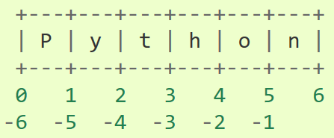
Strings (4/4)
s[ :i] + s[i: ] always equals s
>>> word = ‘Python’
>>> word[ :2] + word[2: ]
'Python'
>>> word[ :4] + word[4: ]
'Python’

Slide 19
Common String Methods
.count(‘x’) # counts the number of occurrences of ‘x’ in str
.find(‘x’) # returns the position of character ‘x’
.lower() # returns the stringVar in lowercase (this is temporary)
.upper() # returns the stringVar in uppercase (this is temporary)
.replace(‘a’, ‘b’) # replaces all occurrences of a with b in the string
.strip() # removes leading/trailing white space from string

Slide 20
Lists (1/5)
>>> squares = [1, 4, 9, 16, 25]
>>> squares
[1, 4, 9, 16, 25]
>>> squares[0] # indexing returns the item
1
>>> squares[-1]
25
>>> squares[-3:] # slicing returns a new list
[9, 16, 25]

Slide 21
Lists (2/5)
>>> squares + [36, 49, 64, 81, 100]
[1, 4, 9, 16, 25, 36, 49, 64, 81, 100]
>>> cubes = [1, 8, 27, 65, 125] # something's wrong here
>>> 4 ** 3 # the cube of 4 is 64, not 65!
64
>>> cubes[3] = 64 # replace the wrong value
>>> cubes
[1, 8, 27, 64, 125]
>>> cubes.append(216) # add the cube of 6
[1, 8, 27, 64, 125, 216]

Slide 22
Lists (3/5)
>>> letters = ['a', 'b', 'c', 'd', 'e', 'f', 'g']
>>> letters
['a', 'b', 'c', 'd', 'e', 'f', 'g']
>>> # replace some values
>>> letters[2:5] = ['C', 'D', 'E']
>>> letters
['a', 'b', 'C', 'D', 'E', 'f', 'g']
>>> # now remove them
>>> letters[2:5] = []
>>> letters
['a', 'b', 'f', 'g']

Slide 23
Lists (4/5)
>>> # clear the list by replacing all the elements with an empty list
>>> letters[:] = []
>>> letters
[]
>>> letters = ['a', 'b', 'c', 'd']
>>> len(letters)
4

Slide 24
Lists (5/5)
>>> a = ['a', 'b', 'c']
>>> n = [1, 2, 3]
>>> x = [a, n]
>>> x
[['a', 'b', 'c'], [1, 2, 3]]
>>> x[0]
['a', 'b', 'c']
>>> x[0][1]
'b'

Slide 25
Common List Methods
.append(value) # appends element to end of the list
.count(‘x’) # counts the number of occurrences of ‘x’ in the list
.index(‘x’) # returns the index of ‘x’ in the list
.insert(‘y’,’x’) # inserts ‘x’ at location ‘y’
.pop() # returns last element then removes it from the list
.remove(‘x’) # finds and removes first ‘x’ from list
.reverse() # reverses the elements in the list
.sort() # sorts the list alphabetically ascending, or numerical ascending

Slide 26
Tuples
What if you need a list that you wish not to change, i.e. add, update, and delete elements is not allowed?
# Use Tuples
>>> myTuple = (1,2,3)
>>> Print(myTuple)
>>> myTuple.add(4) # should be an error

Slide 27
Tuple to List to Tuple
>>> myTuple = (1,2,3)
>>> print(myTuple)
(1, 2, 3)
>>> myList = list(myTuple)
>>> myList.append(4)
>>> print(myList)
[1, 2, 3, 4]
>>> myNewTuple = tuple(myList)

Slide 28
Let’s write a short program
# Fibonacci series:
# sum of two elements defines the next
>>> a, b = 0, 1
>>> while a < 10:
... print(a)
... a, b = b, a+b
...
0
1

Slide 29
print some values
>>> i = 256*256
>>> print('The value of i is ', i)
The value of i is 65536
>>> a, b = 0, 1
>>> while a < 1000:
... print(a, end=',')
... a, b = b, a+b
...
0,1,1,2,3,5,8,13,21,34,55,89,144,233,377,610,987,

Slide 30
Control Flow: if Statement
a = 20
if a >= 22:
print("if")
elif a >= 21:
print("elif")
else:
print("else")

Slide 31
Control Flow: if Statement
>>> x = int(input("Please enter an integer: "))
Please enter an integer: 60
>>> if x < 0:
... x = 0
... print('Negative changed to zero')
... elif x == 0:
... print('Zero')
... else x == 1:
... print('More')

Slide 32
Exercise
>>> height = 1.75
>>> weight = 78
>>> bmi = weight / height ** 2
>>> print(bmi)
Compute BMI as you take height and weight as input from user

Slide 33
Control Flow: for Statement
>>> for a in range(1,3):
print (a)

Slide 34
Control Flow: for Statement
# Measure some strings:
>>> words = ['cat', 'window', 'defenestrate']
>>> for w in words:
... print(w, len(w))
...
cat 3
window 6
defenestrate 12

Slide 35
Control Flow: for Statement
>>> for w in words[:]: # Loop over a slice copy of the entire list.
... if len(w) > 6:
... words.insert(0, w)
...
>>> words
['defenestrate', 'cat', 'window', 'defenestrate']

